Slide 1
How to obtain DSLS ID
Go to https://www.3ds.com/terms/software-keys/ and find below section
This link will show video how to obtain ID
You can download program to obtain ID

Slide 2
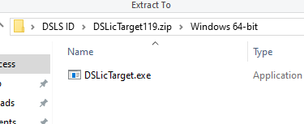
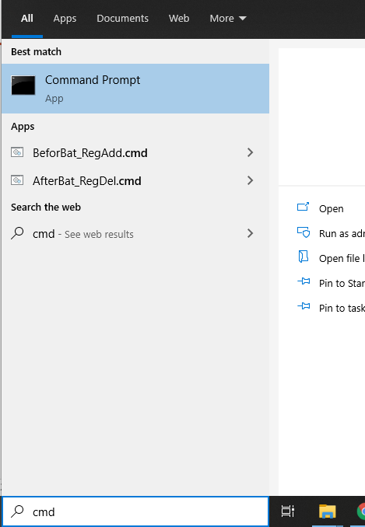
Navigate to the program just downloaded
Unzip DSLicTarget.exe found in Windows-64-bit folder and save it to Desktop
Open command prompt
Once unzipped, DSLicTarget.exe should be at Desktop

Slide 3
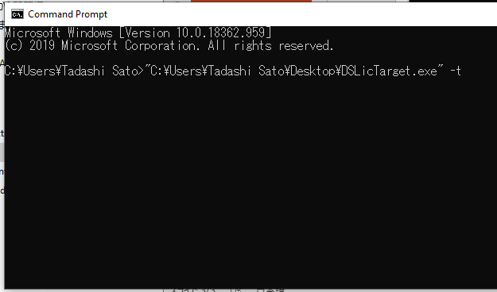
Set path to DSLicTarget.exe in Command prompt and add –t at the end.
In this example:
"C:\Users\User name\Desktop\DSLicTarget.exe“ -t
Should get Computer ID, send this ID to GVT

